Slide 1


Android Application Development
Unit – 4
Working with Data and Storage in Android
Prof. Hardik Chavda
FOCA,MU

Slide 2

Unit – 4
Dialogs
AlertDialogs
Creating, saving and retrieving Shared Preferences
Managing and working with data using SQLite
Sharing data between Applications using Content Provider
Understanding Content URI
ContentResolver
Internal Storage
External Storage

Slide 3
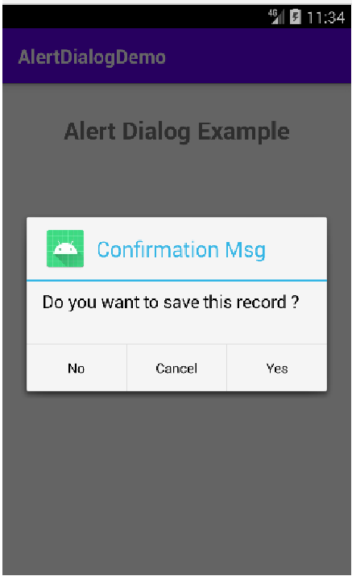
Dialogs
A dialog is a small window that prompts the user to make a decision or enter additional information.
A dialog does not fill the screen and is normally used for modal events that require users to take an action before they can proceed.
A dialog that can show a title, up to three buttons, a list of selectable items, or a custom layout.

Slide 4
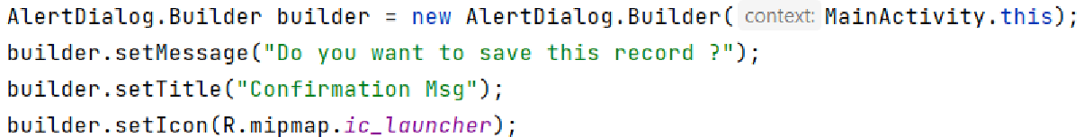
AlertDialog.Builder
Android AlertDialog can be used to display the dialog message with OK and Cancel buttons.
It can be used to interrupt and ask the user about his/her choice to continue or discontinue.
Android AlertDialog is composed of three regions: title, content area and action buttons.

Slide 5
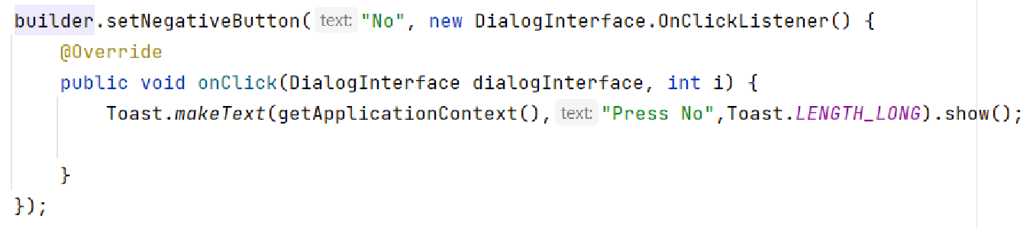
Few builder class methods :
setPositiveButton ( ) : for display yes button
setNegativeButton( ) : for display No button
setNeutralButton ( ) : For cancel button…

Slide 6
Concept of SharedPreferences
One of the most Interesting Data Storage options Android provides its users is Shared Preferences.
Shared Preferences is the way in which one can store and retrieve small amounts of primitive data as key/value pairs to a file on the device storage such as String, int, float, Boolean that make up your preferences in an XML file inside the app on the device storage.
Shared Preferences can be thought of as a dictionary or a key/value pair.

Slide 7
SharedPreferences is application specific, i.e. the data is lost on performing one of the following options:
on uninstalling the application
on clearing the application data (through Settings)
To get access to the preferences, we have three Methods to choose from:
getPreferences() : used from within your Activity, to access activity-specific preferences
getSharedPreferences() : used from within your Activity (or other application Context), to access application-level preferences
getDefaultSharedPreferences() : used on the PreferenceManager, to get the shared preferences that work in concert with Android’s overall preference framework

Slide 8
Modes in for securing Data in shared preferences.
MODE_PRIVATE: the default mode, where the created file can only be accessed by the calling application
MODE_APPEND: This will append the new preferences with the already existing preferences.
MODE_WORLD_READABLE: Creating world-readable files is very dangerous, and likely to cause security holes in applications
MODE_WORLD_WRITEABLE: Creating world-writable files is very dangerous, and likely to cause security holes in applications

Slide 9
Managing and working with data using SQLite
SQLite is an open-source relational database i.e. used to perform database operations on android devices such as storing, manipulating or retrieving persistent data from the database.
It is embedded in android bydefault. So, there is no need to perform any database setup or administration task.
SQLiteOpenHelper class provides the functionality to use the SQLite database.
The android.database.sqlite.SQLiteOpenHelper class is used for database creation and version management. For performing any database operation, you have to provide the implementation of onCreate() and onUpgrade() methods of SQLiteOpenHelper class.

Slide 10
Constructors of SQLiteOpenHelper class
SQLiteOpenHelper(Context context, String name, SQLiteDatabase.CursorFactory f actory, int version)
creates an object for creating, opening and managing the database.
SQLiteOpenHelper(Context context, String name, SQLiteDatabase.CursorFactory factory, int version, DatabaseErrorHandlererrorHandler)
creates an object for creating, opening and managing the database. It specifies the error handler.

Slide 11
Methods of SQLiteOpenHelper class
public abstract void onCreate(SQLiteDatabase db)
called only once when database is created for the first time.
public abstract void onUpgrade(SQLiteDatabase db, int oldVersion, int newVersion)
called when database needs to be upgraded.
public synchronized void close()
closes the database object.
public void onDowngrade(SQLiteDatabase db, int oldVersion, int newVersion)
called when database needs to be downgraded.

Slide 12
SQLiteDatabase class
void execSQL(String sql)
executes the sql query not select query.
long insert(String table, String nullColumnHack, ContentValues values)
inserts a record on the database. The table specifies the table name,nullColumnHack doesn't allow completely null values. If second argument is null, android will store null values if values are empty. The third argument specifies the values to be stored.
int update(String table, ContentValues values, String whereClause, String[] whereArgs)
updates a row.
Cursor query(String table, String[] columns, String selection, String[] selectionArgs, String groupBy, String having, String orderBy)
returns a cursor over the resultset.

Slide 13
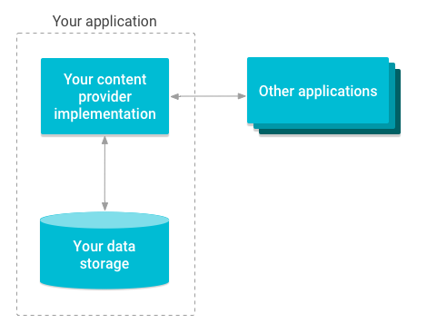
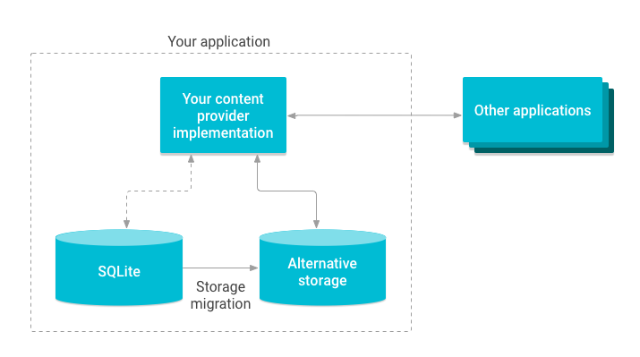
Content Providers
Content providers can help an application manage access to data stored by itself, stored by other apps, and provide a way to share data with other apps.
They encapsulate the data, and provide mechanisms for defining data security. Content providers are the standard interface that connects data in one process with code running in another process.
This abstraction allows you to make modifications to your application data storage implementation without affecting other existing applications that rely on access to your data.
In this scenario only your content provider is affected and not the applications that access it.
For example, you might swap out a SQLite database for alternative storage.

Slide 14
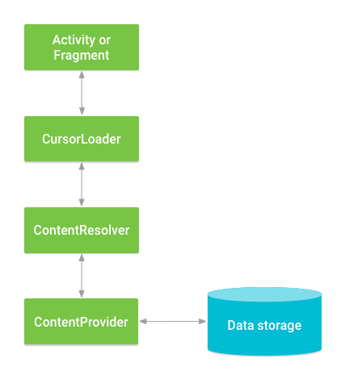
Accessing Provider
When you want to access data in a content provider, you use the ContentResolver object in your application's Context to communicate with the provider as a client. The ContentResolver object communicates with the provider object, an instance of a class that implements ContentProvider. The provider object receives data requests from clients, performs the requested action, and returns the results.
A content provider behaves very much like a database where you can query it, edit its content, as well as add or delete content using insert(), update(), delete(), and query() methods. In most cases this data is stored in an SQlite database.
A content provider is implemented as a subclass of ContentProvider class and must implement a standard set of APIs that enable other applications to perform transactions.

Slide 15
Content URIs
To query a content provider, you specify the query string in the form of a URI which has following format :
Sr.No | Part & Description
1 | Prefix : This is always set to content://
2 | Authority : This specifies the name of the content provider, for example contacts, browser etc. For third-party content providers, this could be the fully qualified name, such as com.mu.statusprovider
3 | data_type : This indicates the type of data that this particular provider provides. For example, if you are getting all the contacts from the Contactscontent provider, then the data path would be people and URI would look like thiscontent://contacts/people
4 | Id : This specifies the specific record requested. For example, if you are looking for contact number 5 in the Contacts content provider then URI would look like this content://contacts/people/5.

Slide 16
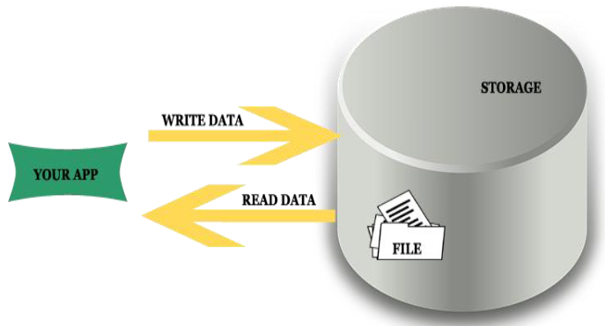
Internal Storage
These directories include both a dedicated location for storing persistent files, and another location for storing cache data.
The system prevents other apps from accessing these locations, and on Android 10 (API level 29) and higher, these locations are encrypted.
These characteristics make these locations a good place to store sensitive data that only your app itself can access.

Slide 17
When the user uninstalls your app, the files saved in app-specific storage are removed.
Because of this behaviour, you shouldn't use this storage to save anything that the user expects to persist independently of your app.
For example, if your app allows users to capture photos, the user would expect that they can access those photos even after they uninstall your app. So you should instead use shared storage to save those types of files to the appropriate media collection.
String filename = “FOCA";
String fileContents = “I am student studying in FOCA Department!";
try (FileOutputStream fos = context.openFileOutput(filename, Context.MODE_PRIVATE)) {
fos.write(fileContents.toByteArray());
}

Slide 18
Modes
MODES:
MODE_PRIVATE — In private mode the data stored earlier is always overridden by the current data i.e every time you try to commit a new write to a file which removes or override the previous content. We have used MODE_PRIVATE in the example at the end of this article.
MODE_APPEND — In this mode the data is append to the existing content i.e keep adding data.

Slide 19
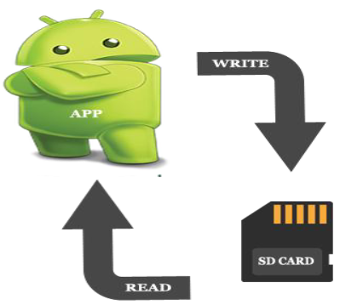
External Storage
These directories include both a dedicated location for storing persistent files, and another location for storing cache data.
Although it's possible for another app to access these directories if that app has the proper permissions, the files stored in these directories are meant for use only by your app.
If you specifically intend to create files that other apps should be able to access, your app should store these files in the shared storage part of external storage instead.

Slide 20
Methods to Store Data In Android
getExternalStorageDirectory() – Older way to access external storage in API Level less than 7. It is absolute now and not recommended. It directly get thereference to the root directory of your external storage or SD Card.
getExternalFilesDir(String type) – It is recommended way to enable us to create private files specific to app and files are removed as app is uninstalled. Example is app private data.
getExternalStoragePublicDirectory() : This is current recommended way that enable us to keep files public and are not deleted with the app uninstallation. Example images clicked by the camera exists even we uninstall the camera app.
On Android 4.4 (API level 19) or higher, your app doesn't need to request any storage-related permissions to access app-specific directories within external storage.
The files stored in these directories are removed when your app is uninstalled.

Slide 21
Verify that storage is available
Important Note: It is necessary to add external storage the permission to read and write. For that
you need to add permission in android Manifest file.
<uses-permission android:name="android.permission.WRITE_EXTERNAL_STORAGE" />
<uses-permission android:name="android.permission.READ_EXTERNAL_STORAGE" />
You can query the volume's state by calling Environment.getExternalStorageState().
If the returned state is MEDIA_MOUNTED, then you can read and write app-specific files within external storage. If it's MEDIA_MOUNTED_READ_ONLY, you can only read these files.

Slide 22
Public Directories
In Android, the public directories are specific folders where apps can access common types of data. Here are some of the commonly used public directories in Android:
Environment.DIRECTORY_DOCUMENTS: This directory is used for documents that are created by the user.
Environment.DIRECTORY_DOWNLOADS: This directory is used for downloaded files.
Environment.DIRECTORY_DCIM: This directory is used for camera photos.
Environment.DIRECTORY_MOVIES: This directory is used for movies.
Environment.DIRECTORY_MUSIC: This directory is used for music files.
Environment.DIRECTORY_PICTURES: This directory is used for pictures.
Environment.DIRECTORY_ALARMS: This directory is used for alarm sounds.
Environment.DIRECTORY_NOTIFICATIONS: This directory is used for notification sounds.
Environment.DIRECTORY_RINGTONES: This directory is used for ringtones.
Path: Environment.getExternalStoragePublicDirectory(Environment.DIRECTORY_DOCUMENTS)

Slide 23
Example of one public directory.
File getAppSpecificAlbumStorageDir(Context context, String albumName) {
// Get the pictures directory that's inside the app-specific directory on
// external storage.
File file = new File(context.getExternalFilesDir(
Environment.DIRECTORY_PICTURES), albumName);
if (file == null || !file.mkdirs()) {
Log.e(LOG_TAG, "Directory not created");
}
return file;
}

